Slide 1
Thyroid Prediction using data mining
ROSHAN AZARUDDIN G(211419205138) GUIDED BY
PAVANRAJ R(211419205123) mr.A.BALAJI m.e.
VIMAL G A (211419205180) ASSISTANT PROFESSOR

Slide 2
OBJECTIVE
To predict thyroid diseases using different classification techniques.
To compare four classification models, including Naive Bayes, Decision Tree, Logistic Regression, and Random Forest, and determine which model has the best classification rate.
To increase the Accuracy to 99%

Slide 3
SCOPE
To predict thyroid diseases using different classification techniques.
To compare four classification models, including Naive Bayes, Decision Tree, Logistic Regression, and Random Forest, and determine which model has the best classification rate.

Slide 4
Abstract
Data mining techniques are essential for early and accurate diagnosis of thyroid diseases.
This study uses different classification techniques to predict thyroid diseases and explores the correlation between various factors.
Four classification models, including Naive Bayes, Decision Tree, Logistic Regression, and Random Forest, are compared to determine the best classification rate.
The Decision Tree and Random Forest model had the highest classification rate, making it the most effective classification technique for predicting thyroid diseases.

Slide 5
Literature Survey
S. No | Name of the paper | Objective | Pros | Cons
1. | Prediction of thyroid Disease Using Data Mining Techniques | Decision-making, disease diagnosis, and better patient care at lower costs are all made possible by data mining techniques, which are crucial in the healthcare industry. Classification of thyroid disorders is a critical task. This study aims to explore the relationship between TSH, T3, and T4 values and hyper- and hypothyroidism by using several classification approaches to predict thyroid problems. | The authors used multiple classification algorithms to predict thyroid disease, indicating a thorough exploration of the problem. | The paper does not provide a comparison of the results obtained with those from similar studies, which could limit the validity of the findings.
2. | A Comparison of Classification Methods on Diagnosis of Thyroid Diseases | Thyroxine (T4) and triiodothyronine(T3), two hormones that the thyroid gland produces, play a significant role in regulating a number of body activities (T3). Hypothyroidism or hyperthyroidism, which can cause a number of health issues, might come from an imbalance in the production of these hormones Machine learning techniques have been used to classify thyroid diseases using a dataset of 215 instances from the UCI machine learning repository. The Multilayer Perceptron (MLP) strategy has the highest accuracy, reaching to 96.74%, while the Back Propagation Algorithm (BPA) strategy has the lowest accuracy, at 69.77%, according to the results. | The paper provides a detailed explanation of the classification methods used, including decision trees, random forests, and naive Bayes. | The study did not account for potential confounding factors that could impact the accuracy of the classification methods, such as medication usage or comorbidities.

Slide 6
Literature Survey
S. No | Name of the paper | Objective | Pros | Cons
3. | MLTDD: use of machine learning techniques for diagnosis of thyroid gland disorder | This review of the literature focuses on using machine learning algorithms to identify thyroid gland abnormalities. The study emphasises the necessity of classification algorithms and huge datasets with powerful computer units to improve the precision of these approaches. The UCI repository was utilised to retrieve the dataset for this investigation. The classification of disorders affecting either an underactive or an overactive thyroid gland using a decision tree algorithm is the main focus of the study. The study reports a testing accuracy range of 98.7% to 99.8% and a training accuracy of 100%. The study also introduces PyDev, an Eclipse Python IDE, and the MLTDD , an intuitive thyroid gland sickness prediction tool. Making the appropriate decisions for the diagnosis of thyroid illnesses can be significantly assisted by the MLTDD. | The paper proposes a new method called MLTDD (Machine Learning Thyroid Diagnosis Detector) which is designed to diagnose thyroid gland disorder. | The study only used a limited dataset with a small number of features, which may not represent the entire population or be generalizable to other datasets.
4. | Predictive data mining for diagnosis of thyroid disease using neural network | In this research, a methodical approach for an early diagnosis of thyroid ailment is proposed using the neural network backpropagation methodology. This field frequently employs the backpropagation algorithm. The development of ANN is based on the backpropagation of error method for illness prediction. Then, using experimental data, ANN was trained. Testing was done using data that wasn't used in training. Findings reveal that the ANN's predictions are in good agreement with the experimental data, suggesting that using a built neural network as an alternative to make disease predictions sooner may be useful. | The paper presents an impressive accuracy rate of 98.3%, indicating that the neural network model is a promising technique for thyroid disease diagnosis. | The study lacks information about the features used in the model and how they are selected, which hinders the ability to reproduce the results.

Slide 7
Literature Survey
S. No | Name of the paper | Objective | Pros | Cons
5. | A segmentation method and comparison of classification methods for thyroid ultrasound images | Bayesian, K-Nearest Neighbor, and Support Vector Machine were three classification methods whose efficacy was contrasted. Support Vector Machine performed better than Bayesian and K-Nearest Neighbor, according to the study's findings, obtaining an accuracy rate of 84.62%. For finding the closest neighbourhood to classify, the k-Nearest Neighbor algorithm was discovered. The probability of the sample data falling into a certain class was used by the Bayesian algorithm to classify the data. Each object was represented as a vertex in a graph that displayed the study's findings. The results imply that Support Vector Machine is a more effective option for precise categorization in data mining and decision-making tasks. | The study provides a comparison of various classification methods for thyroid ultrasound images, which can help in selecting the most appropriate method. | the sample size used in the study is relatively small, which may affect the generalizability of the results.
6. | Predicting thyroid disease using linear discriminant analysis (LDA) data mining technique | More women than males suffer from thyroid disease, which is a prevalent illness. It can produce a number of adverse effects, such as stress and weight gain or loss, and presents as either a hypothyroid or hyperthyroid condition. An early diagnosis of the condition is necessary for prompt treatment. In healthcare companies, data mining techniques are often utilised to forecast and identify diseases. In this study, a supervised learning technique called linear discriminant analysis (LDA), which is used for classification, is applied to predict hypothyroid illness. The UCI repository was utilised to get the dataset for the investigation. Among various classification algorithms including CART, REP Tree, and J48, LDA was determined to have the highest accuracy, with a cross-validation k=6 score of 99.62%. | The paper focuses on using Linear Discriminant Analysis (LDA) as a data mining technique for predicting thyroid disease, which is a unique approach compared to other papers that mainly used SVM or neural network. | The paper does not provide a detailed discussion of the findings or the implications of the study, which can limit the impact of the research.

Slide 8
Literature Survey
S. No | Name of the paper | Objective | Pros | Cons
7. | Thyroid disorder analysis using random forest classifier. | The way people live today is to blame for the rise of diseases. A rise in thyroid disorders is also evident. Thyroid disorders come in two different forms. Hypothyroidism results from an abundance of thyroid hormone in the circulatory system, whereas hyperthyroidism is caused by a deficiency of thyroid hormone in the circulatory system. It takes sufficient expertise and information to diagnose the disease. This makes thyroid disease diagnosis challenging. The problem is more accurately simplified by the use of data mining techniques. The random forest classification technique is utilised in this suggested study to examine the hypothyroidism problem, and its effectiveness is contrasted with that of other algorithms like sequential minimum optimisation (SMO), decision tables, and K-star classifier. | The use of random forest classifier is a popular and effective machine learning technique for classification tasks. | The study does not provide a comparison of the performance of the random forest classifier with other classification algorithms, limiting the ability to draw conclusions about the effectiveness of the model compared to other methods
8. | Prediction of Thyroid Disease Using Data Mining Techniques | This study's major objective is to classify hypothyroidism and hyperthyroidism , two of the most prevalent thyroid conditions. The authors compared and evaluated four classification models: Radial Basis Function Network, Naive Bayes, Multilayer Perceptron and Decision Tree . From the various classification models, the Decision Tree model showed the most accuracy and had the highest classification rate. | The paper uses a classification technique based on SVM, which is a widely used machine learning algorithm. | The paper has a limited scope, as it only focuses on using SVM for predicting thyroid disease and does not explore other data mining techniques that can be used for this task.

Slide 9
Existing System
Thyroid disease diagnosis involves various tests such as blood tests, physical examination of the thyroid gland, imaging tests, and biopsy to identify any abnormalities.
Blood tests measure thyroid hormone levels (T3 and T4) and thyroid-stimulating hormone (TSH) to diagnose hypothyroidism and hyperthyroidism.
Physical examination of the thyroid gland involves checking for lumps or nodules.
Imaging tests such as ultrasounds, CT scans, and MRIs are used to identify any abnormalities in the thyroid gland.
Diagnosis of thyroid disease requires a comprehensive evaluation of a patient's symptoms, medical history, physical examination, and laboratory and imaging tests to provide timely and effective treatment.

Slide 10
Proposed System
The proposed system utilizes a thyroid dataset obtained from the UCI data repository, which contains records of thyroid patients with various attributes.
The system applies data mining techniques to predict thyroid disease, which is extensively used in healthcare services to improve decision-making, diagnose diseases, and provide better treatment to patients at a lower cost.
Accurately classifying thyroid disease is a crucial step in disease prediction, and in the future, dimensionality reduction may be implemented to reduce the number of blood tests required for diagnosis and save time.
The system uses 80% of the dataset for training and the remaining 20% for testing, with Decision tree and Random forest algorithms used to predict thyroid disease.
Through research, it was found that Decision tree has an accuracy of 92%-94%, while Random forest has an accuracy of 94%-95%.

Slide 11
Proposed System
To increase the accuracy of the system, the predictions from both algorithms are combined to reach an accuracy of above 99.5%.
In an effort to further improve accuracy, the above process is repeated for 5 iterations and the most repeated value is chosen as the final answer.
The proposed system is able to accurately predict thyroid disease, which can lead to better patient outcomes and quality of life.
The system may have the potential to improve the efficiency and accuracy of thyroid disease diagnosis and reduce healthcare costs.
The proposed system could be further refined and developed, potentially leading to new and improved methods for predicting and diagnosing thyroid disease.

Slide 12
Requirements and specification
Python 3.10
SCIKIT Learn
Python-Flask
Pycharm IDE
HTML
CSS
Javascript

Slide 13
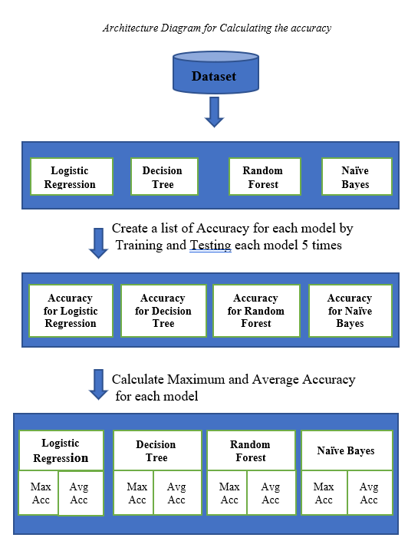
Architecture diagram

Slide 14
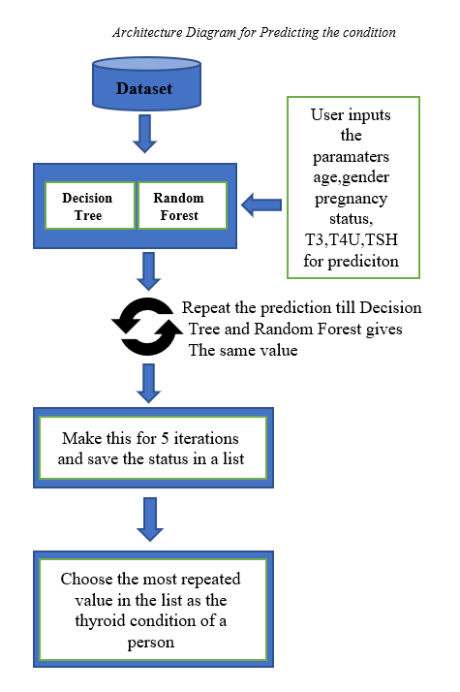
Architecture diagram

Slide 15
Algorithm
Decision Tree
Decision tree is a popular machine learning algorithm used for classification and regression tasks.
It builds a model by recursively splitting the data into smaller subsets based on the features that are most useful in predicting the target variable.
Each internal node of the tree represents a decision based on one of the input features, and each leaf node represents a class label or a numeric value.

Slide 16
Algorithm
Random Forest
Random forest is an ensemble learning algorithm that combines multiple decision trees to improve the accuracy and stability of the model.
It works by creating multiple decision trees using random subsets of the training data and random subsets of the features for each tree.
The output of the random forest is determined by aggregating the predictions of all the individual trees in the forest, typically through a majority vote.

Slide 17
Algorithm
Logistic Regression
Logistic Regression is a statistical model used to predict a binary outcome (i.e., a variable that can have one of two possible values).
It is a type of supervised learning algorithm that can be used for both classification and regression problems.
The goal of logistic regression is to find the best-fitting relationship between the independent variables and the dependent variable, which is typically a probability value ranging from 0 to 1.

Slide 18
Algorithm
Naïve Bayes
Naive Bayes is a probabilistic algorithm used for classification tasks.
It is based on Bayes' theorem and assumes that features are independent of each other.
Naive Bayes is particularly useful for high-dimensional datasets and works well with a small number of training samples.

Slide 19
Novelty
Our proposed system includes a novel method of training and testing a separate model for pregnant women, which improves the accuracy of diagnosis specifically for this group.
Another novel method involves the use of probability techniques to increase the overall accuracy of the system by combining the prediction results from both decision tree and random forest models.

Slide 20
Modules Split up
Preprocessing the data: In this module, the input data is preprocessed. This includes the removal of any missing values from the dataset.
Selecting the relevant features: In this module, the relevant features for the machine learning model are selected. The chosen features are 'AGE', 'GENDER', 'T3', 'T4U', and 'TSH'.
Training the model: In this module, the chosen machine learning model is trained using the selected features. The available machine learning models to choose from are Decision Tree, Logistic Regression, Random Forest, and Naive Bayes. The function splits the data into training and testing sets, fits the chosen model, and evaluates its accuracy. The trained model is then saved for future use.
Making a prediction: In this module, the trained machine learning model is used to make a prediction for a new data point.

Slide 21
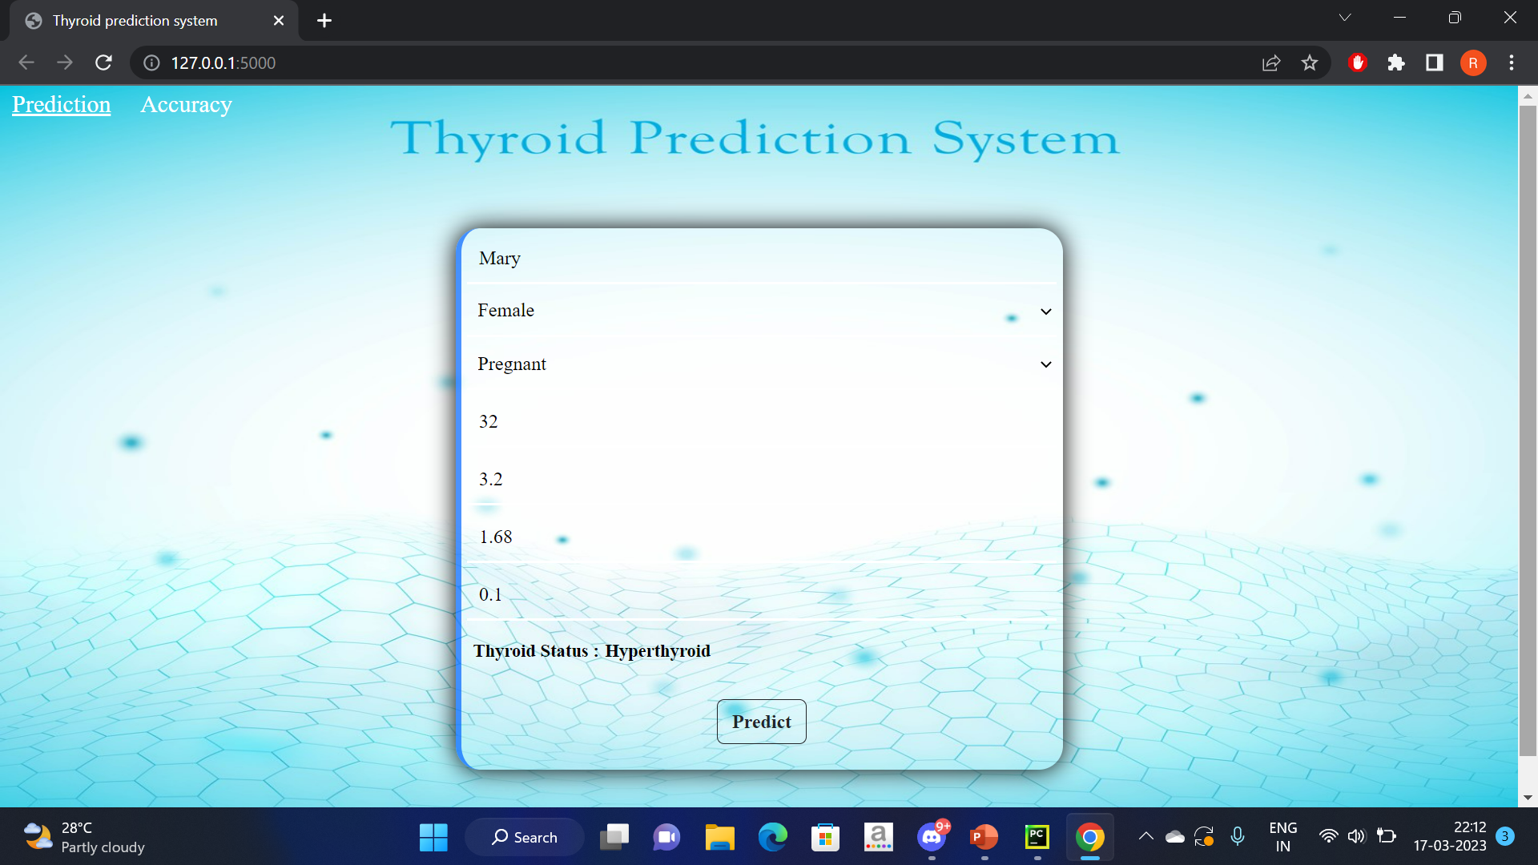

Slide 22
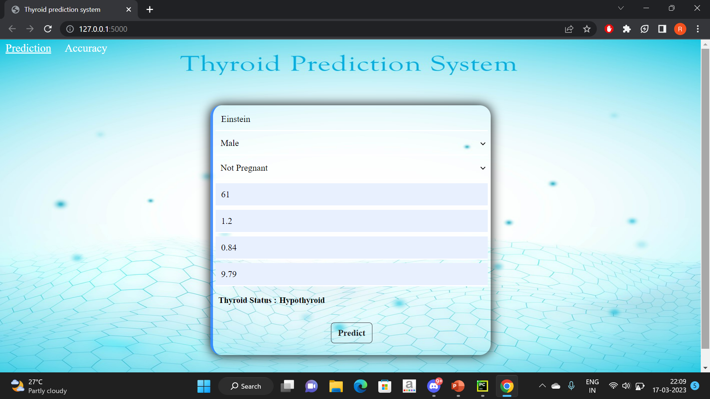
Output Snapshots

Slide 23
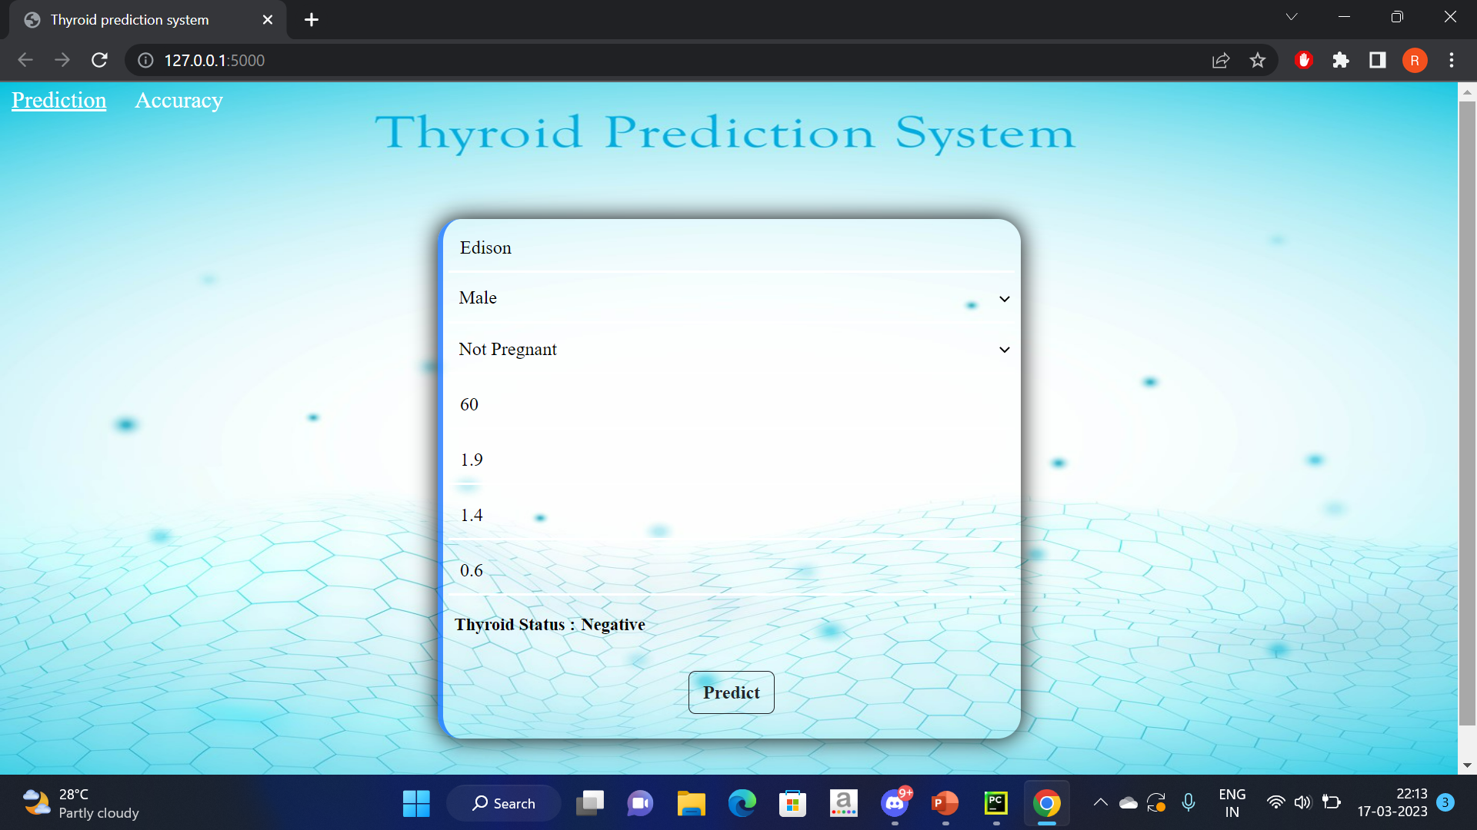

Slide 24
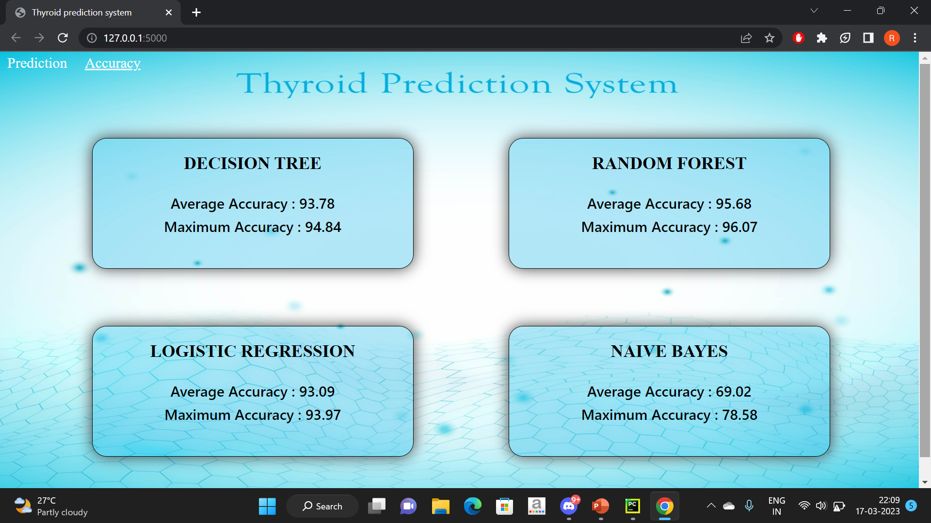

Slide 25
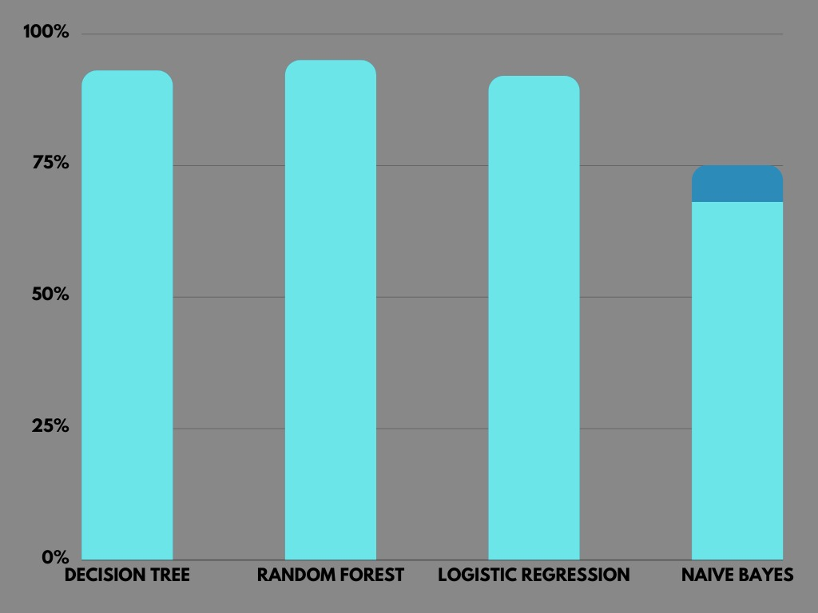
Performance measures of Proposed System
Initial Accuracy
MODEL | DECISION TREE | RANDOM FOREST | LOGISTIC REGRESSION | NAÏVE BAYES
ACCURACY | 93% | 95% | 92% | 68-75%

Slide 26
Combine two model and increase the accuracy
Probability of Decision tree choosing the right answer=0.93
Probability of Random forest choosing the right answer=0.95
Probability of both choosing the right answer=0.93*0.95=0.883
Probability of Decision tree choosing the wrong answer=0.07
Probability of Random forest choosing the wrong answer=0.05
Probability of both choosing the wrong answer=0.07*0.05=0.0035
Probability of both choosing the same answer=0.883+0.0035=0.8865
Probability of choosing different answers=1-0.8865=0.1135
(As we are not going to take different answers into consideration we can just ignore that)
So make the probability of choosing the same answer to 1
=0.8865*(1/0.8865)=1
Probability of choosing the right answer=0.883*(1/0.8865)=0.9961=99.61%
Probability of choosing the wrong answer=0.0035*(1/0.8865)=0.0039=0.39%

Slide 27
CONCLUSION
The study demonstrates the effectiveness of data mining algorithms, particularly Random Forest, in classifying thyroid disease. Early detection and diagnosis of thyroid disease are critical for effective treatment, and data mining techniques can significantly aid healthcare professionals in this area. Naïve Bayes, Logistic regression and Decision tree algorithms can also provide accurate results and improve patient management by reducing noisy data. These findings are useful for researchers and medical professionals to identify cost-effective treatment strategies and provide better patient care.

Slide 28
References
[1] Begum and A. Parkavi, "Prediction of thyroid Disease Using Data Mining Techniques," 2019 5th International Conference on Advanced Computing & Communication Systems (ICACCS), Coimbatore, India, 2019, pp. 342-345, doi: 10.1109/ICACCS.2019.8728320.
[2] Irina IoniŃă and Liviu IoniŃă” Prediction of Thyroid Disease Using Data Mining Techniques”The Classification Technique for Talent Management using SVM, (ICCEET), 978-1- 4673-02l0-4/12, pp. 959- 963, 2017.
[3] Hanung Adi Nugroho, Noor Akhmad Setiawan, Md. Dendi Maysanjaya,” A Comparison of Classification Methods on Diagnosis of Thyroid Diseases”IEEE International Seminar on Intelligent Technology and Its Applications,2017.
[4] Al-muwaffaq, Izdihar, and Zeki Bozkus. "MLTDD: use of machine learning techniques for diagnosis of thyroid gland disorder." Comput Sci Inf Technol (2016): 67-3.

Slide 29
References
[5] Prerana, Parveen Sehgal, and Khushboo Taneja. "Predictive data mining for diagnosis of thyroid disease using neural network." International Journal of Research in Management, Science & Technology 3.2 (2015): 75-80.
[6] Singh, Nikita, and Alka Jindal. "A segmentation method and comparison of classification methods for thyroid ultrasound images." International Journal of Computer Applications 50.11 (2012): 43-49.
[7] Banu, G. Rasitha. "Predicting thyroid disease using linear discriminant analysis (LDA) data mining technique." Commun. Appl. Electron.(CAE) 4 (2016): 4-6.
[8] Mishra, Sushruta, et al. "Thyroid disorder analysis using random forest classifier." Intelligent and Cloud Computing: Proceedings of ICICC 2019, Volume 2. Springer Singapore, 2021.

